Slide 1
Middleware Security
Srikanth Gunturu
Guest Faculty
BITS, WILP

Slide 2
In this segment
Middleware Security
Symmetric and Asymmetric keys
Digital Signatures
Message Authentication Codes
Secure Socket Layer / Transport Layer Security

Slide 3
Middleware Security
Symmetric Cryptography and Asymmetric/Public Keys
Symmetric key cryptography - uses the same key to encrypt the text and to decrypt the text
Both the parties need to know the key (offline sync of the keys)
Asymmetric/Public key cryptography - uses two mathematically related keys
Public key
Private key
Message encrypted using either of the keys can be decrypted with the other
Often used to establish secure connection between two entities, to negotiate Symmetric key

Slide 4
Middleware Security
Digital Signatures
Validates the authenticity and integrity of the digital message using asymmetric keys
Sender side:
Digital message is hashed (ex: SHA-1)
Sender’s private key is used to encrypt it
Message is sent along with digital signature
Recipient side:
Digital signature is decrypted using sender’s public key
Message is hashed and compared with decrypted signature
If they match, message is accepted as not tampered

Slide 5
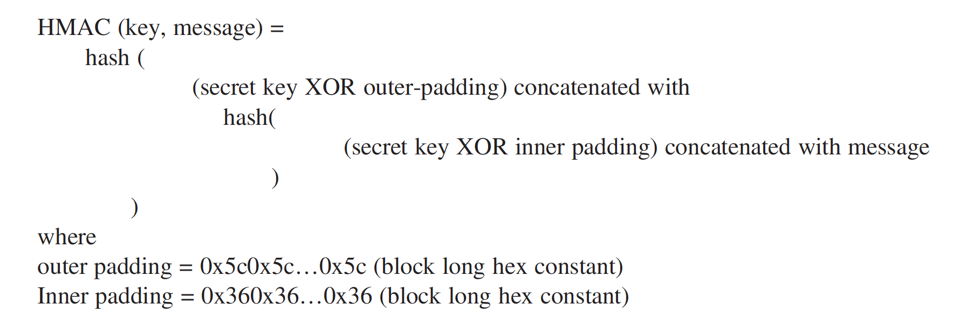
Middleware Security
Message Authentication Codes
Function same as digital signature, but by using symmetric keys
Sender and receiver share same encryption key and use it for encrypting/decrypting the hash
Caveat – A receiver can use the MAC to pretend to be the original sender to a third party
Workaround - Hash based MAC (HMAC) – uses hashing with secret key

Slide 6
Middleware Security
Secure Socket Layer and Transport Layer Security
SSL Evolved in 1990s as security mechanism for HTTP (i.e. HTTPS)
Transport Layer Security (TLS) evolved as follow-on for SSL in late ‘90s
SSL/TLS run on TCP/IP, above HTTP – making it HTTPS
SSL 2.0 Major Limitations (RFC 6175)
MD5 is no longer considered secure
Subject to man-in-the-middle attacks and forced session terminations
Same key used for message integrity and encryption
TLS Sub protocols (RFC 5246)
Record protocol – Encrypts message using MAC
Handshake protocol – Agrees on the algorithm to use in the session
Alert protocol – Error handling
Cipher spec protocol – Changes cipher strategies/signals
Application data protocol – Provides data transparency to applications

Slide 7
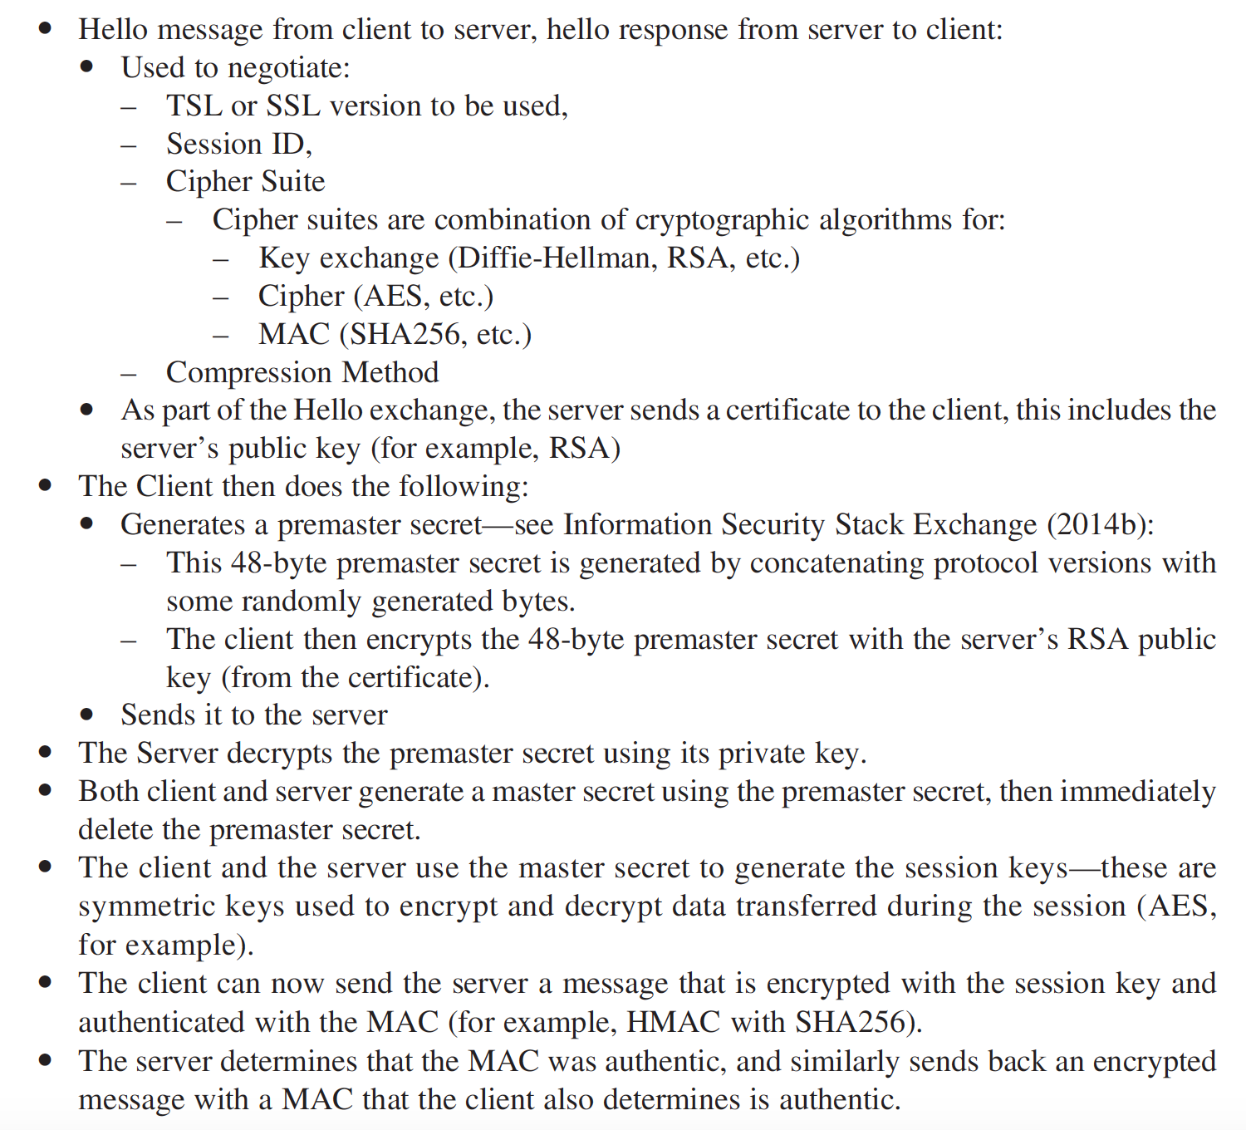
Middleware Security
TLS Handshake Protocol flow

Slide 8
Thank You!
In our next session:
JMS Server setup and configuration

